Slide 1





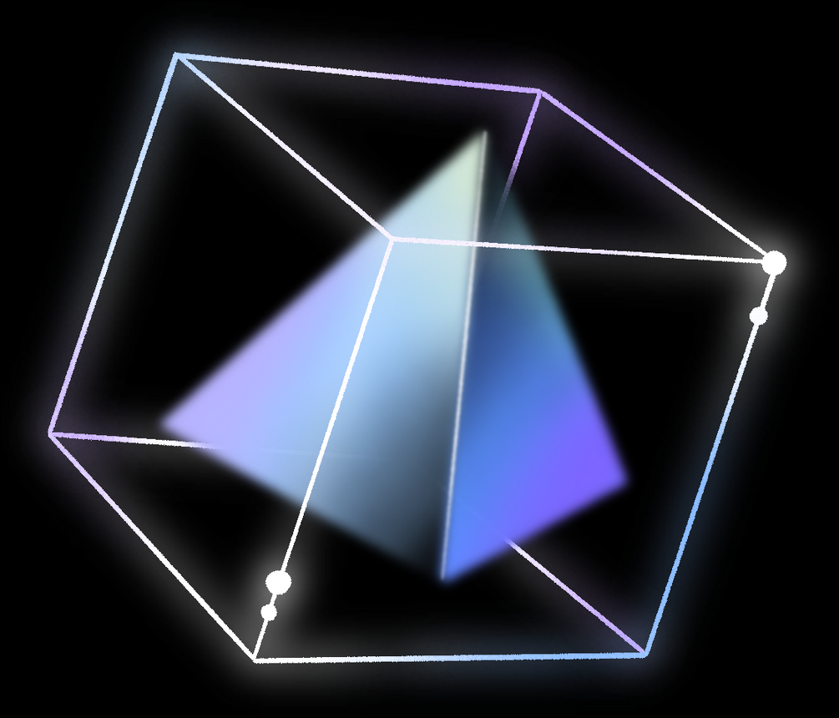
GYM APPLICATOIN
STRENGTHY
Submitted By
Aditya Dutta
2110990088
G-28

Slide 2
TABLE OF CONTENTS
Introduction
Features
Tech Used
Application UI
Conclusion
01
02
03
04
05

Slide 3

INTRODUCTION
This presentation introduces the Gym Web App project, a comprehensive online platform for fitness enthusiasts.

Slide 4







PROJECT FEATURES
SCROLL ANIMATION
SUBSCRIPTION BASED CLASSES
BLOGS

Slide 5


TECH USED
Frontend: HTML, CSS, JavaScript, React
State Management: React Hooks
Routing: React Routing

Slide 6
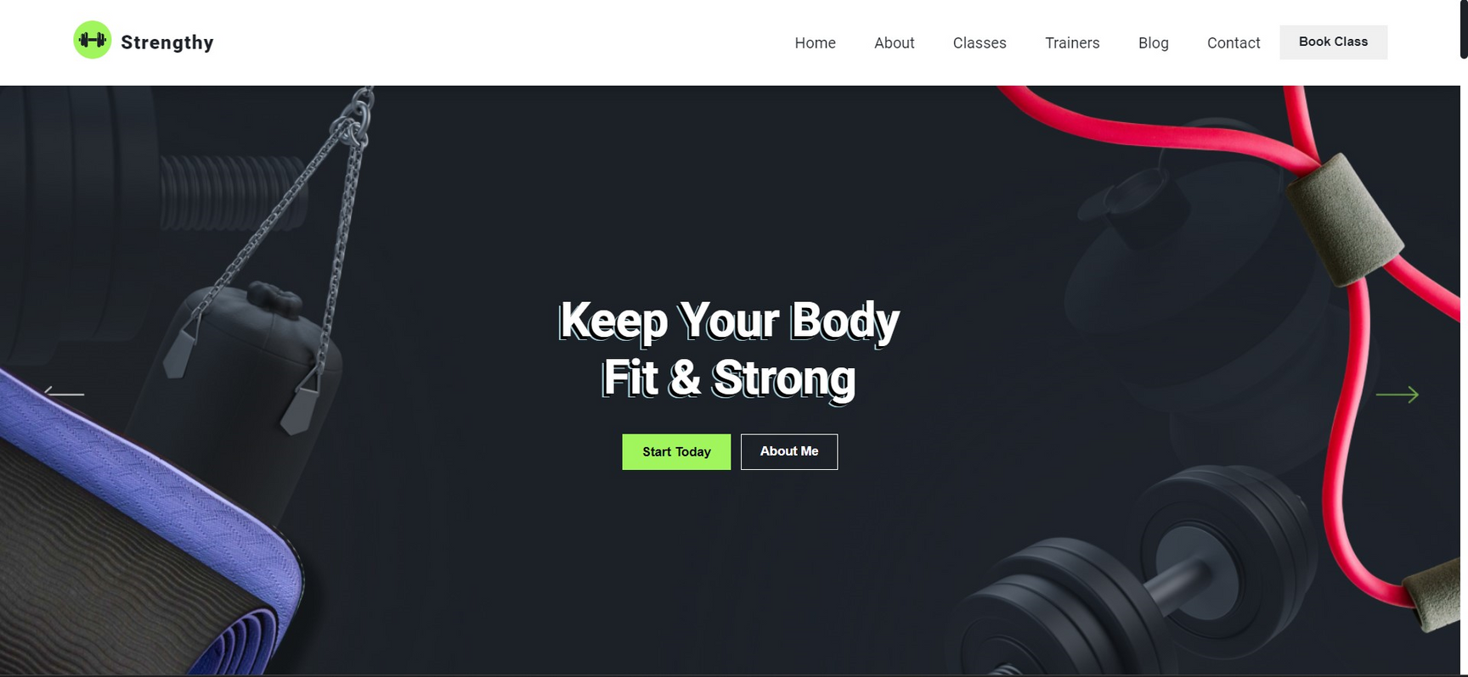

APPLICATION UI

Slide 7



CONCLUSION
The Gym Web App represents a significant step towards promoting fitness and health in a digital era. With its blend of engaging animations, exercise information, subscription-based classes, fitness blogs, and an accessible "Contact Us" feature, it caters to the diverse needs of fitness enthusiasts.

